Slide 1
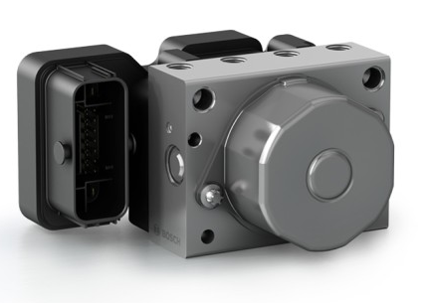
Performance of ABS using LQR over PID Control on μ-split Roads
ME41116 Vehicle Dynamics B
Varun Kotian (4980611)
Nikhil Nagendra (5049628)
Shantanu Shivankar (5032814)
Yen-Lin Wu (4848489)
Source: Bosch
16th June 2020

Slide 2
Contents
Motivation
LQR controller
PID controller
Control Strategy
Experiment Condition
Simulation and Results
Conclusion and Future work

Slide 3
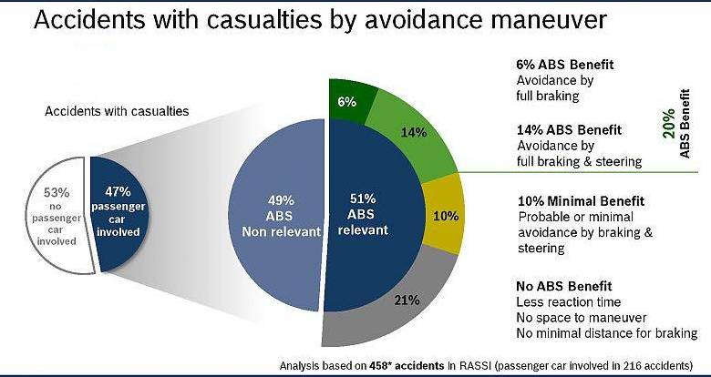
Motivation
NHSTA Passenger vehicle accidents - 2017
Increases the Drivers ability to control the direction of car under hard braking.
Its serves as a good point for selling Vehicles
http://www.cse.msu.edu/~cse470/F01/Projects/ABS/ABS4/web/do-requirements/do-requirements.html#:~:text=1.2%20Motivation,vehicle%20under%20hard%20braking%20conditions.
Charles M. Farmer, Adrian K. Lund, Rebecca E. Trempel, Elisa R. Braver, Fatal crashes of passenger vehicles before and after adding antilock braking systems, Accident Analysis & Prevention, Volume 29, Issue 6, 1997,

Slide 4
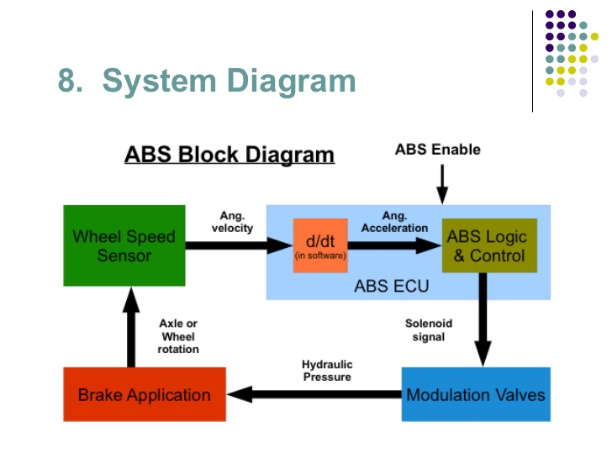
What’s an ABS?
An anti-lock braking system (ABS) is a safety anti-skid braking system used on aircraft and on land vehicles, such as cars, motorcycle, trucks, and busses.

Slide 5
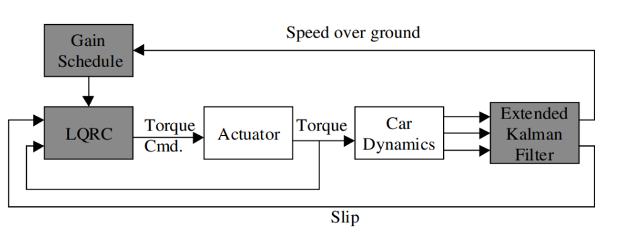
What’s LQR?
LQR is used when the system state : a set of linear differential equations the system cost : quadratic equations.
Cost function: 1) finds out the optimal gain 2) uses gain as feedback to state space equation.
Implementation REQUIRES precise set of state space equations - not feasible in real world; only limited to research purposes.
TU Delft, ME41116, Lecture 3 Slide 9

Slide 6
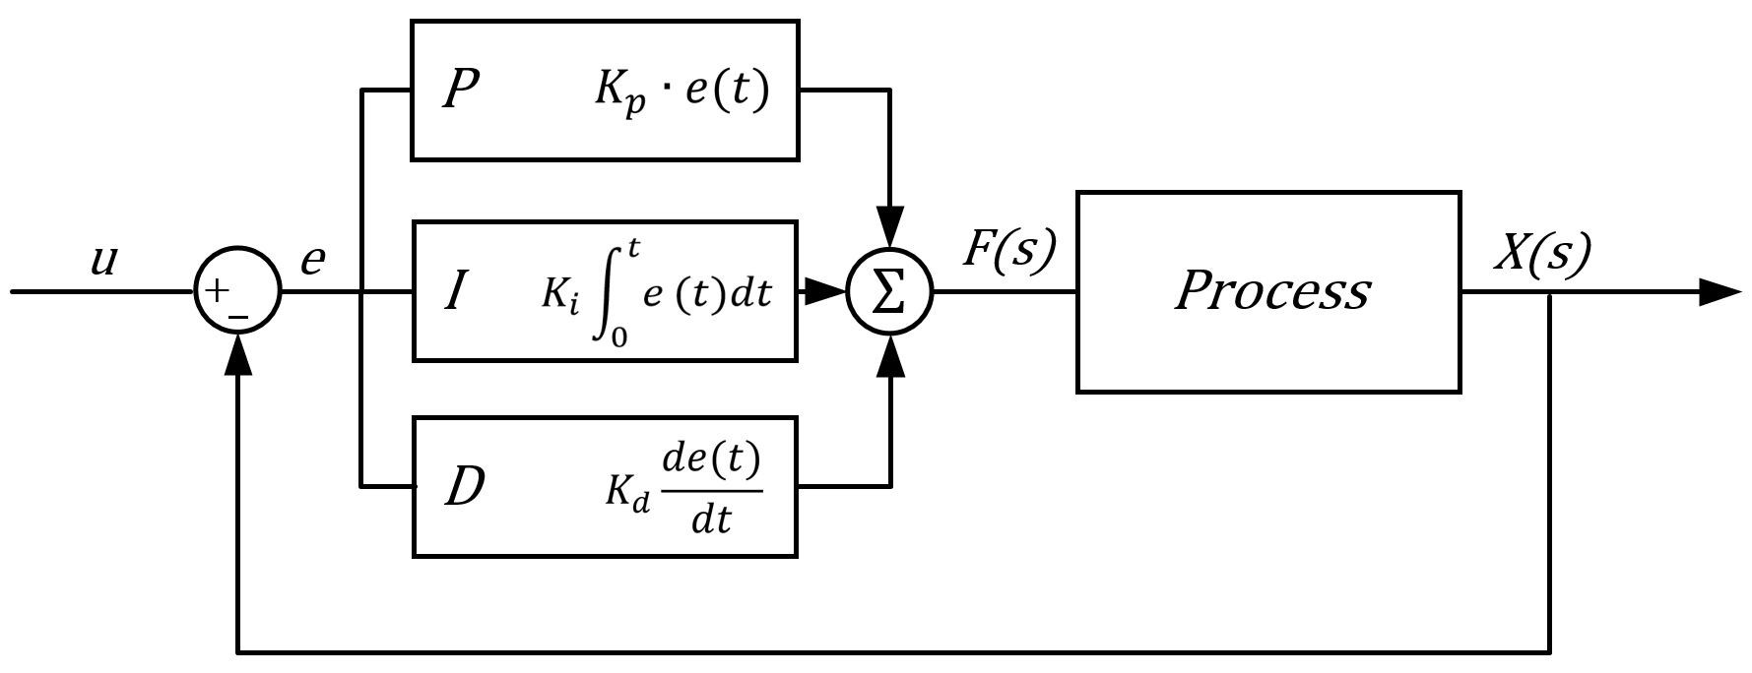
PID Control
A feedback control loop
Applies accurate and responsive correction to a control function
Challenges: constant parameters
Overshoot can only be corrected slowly
Latency when responding to (big) disturbances
Note: In IPG, we use the default hydraulic controller which is a PID controller.
https://university.listenlights.com/2017/11/18/pid-control/
Notes:
A proportional–integral–derivative controller (PID controller or three-term controller) is a control loop mechanism employing feedback
applies accurate and responsive correction to a control function
The use of the PID algorithm does not guarantee optimal control of the system or its control stability (see § Limitations of PID control, below). Situations may occur where there are excessive delays: the measurement of the process value is delayed, or the control action does not apply quickly enough

Slide 7
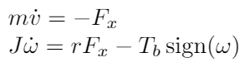
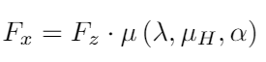
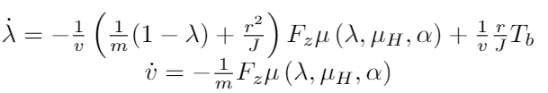
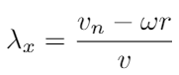
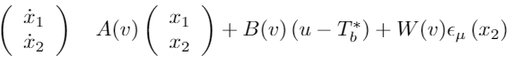
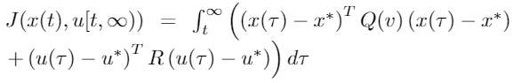
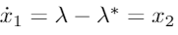
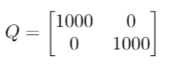
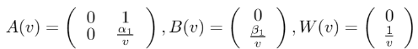
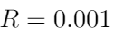
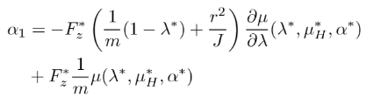
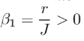
Control Strategy LQR
The change in linear velocity if the vehicle velocity is very slow and cannot be used in the state space equation to control the input.
To make the model more robust and adjust to the every road friction it can encounter we include an integral function. State space equation is given as,
The cost functions is given as,
where,
The state, input and the error matrix,
Weights -
Petersen, T. A. Johansen, J. Kalkkuhl and J. Lüdemann, "Wheel slip control in ABS brakes using gain scheduled constrained LQR," 2001 European Control Conference (ECC), Porto, 2001, pp. 606-611, doi: 10.23919/ECC.2001.7075975.

Slide 8
Initial Conditions
No estimation - direct measurement
No noise in system
Reference slip is constant
Controller deactivation below 5 km/h
Parameters | Value
Mass | 450 Kg
Inertia of the wheel | 1.2 Kg-m^2
Wheel effective radius | 0.305 m
Initial velocity | 120 Km/h
Final velocity | 0 Km/h
Vehicle Type | Audi TT (4WD, DCT)
Vehicle Mass | 1.500 kg
Tyre | RT_225_50R17
Kinematic tyre radius | 0.32 m
Simulation System: i7 processor with 16GB RAM

Slide 9
Experiments
8 tests: w/o controller: w/ LQR: w/ PID:
Road type
High friction
Low friction
Mu Split
𝛍 = 1
𝛍 = 0.5
𝛍 = 1
𝛍 = 0.5
𝛍 = 1
𝛍 = 0.5
𝛍 = 1
𝛍 = 0.5
𝛍 = 1
𝛍 = 1
𝛍 = 0.5

Slide 10
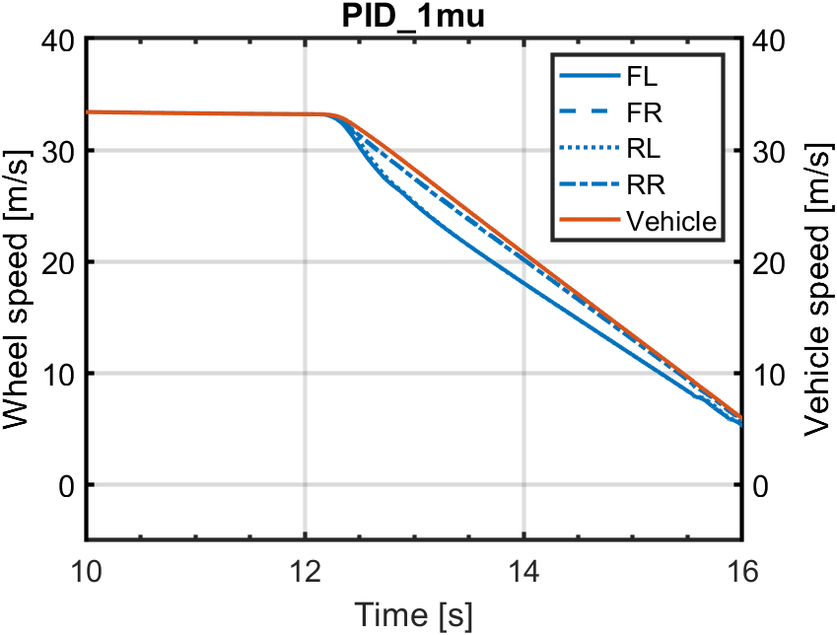
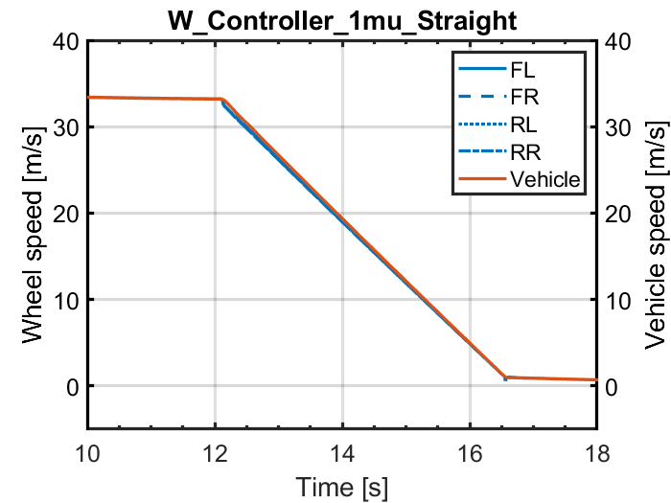
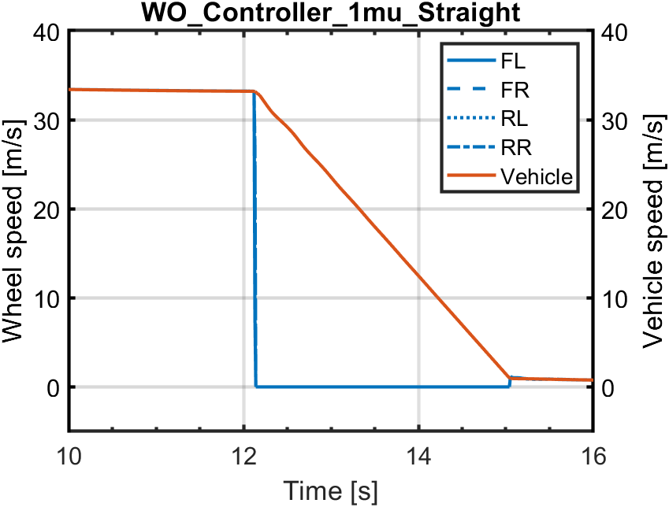
Simulation and Results
Braking on High friction surface (𝛍 = 1)
The car travels straight for 300m at 120km/h and then full brake
𝛍 = 1

Slide 11
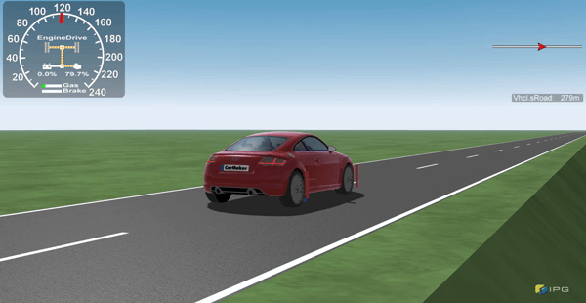

Simulation and Results
w/ Control (𝛍 = 1)
w/o Control (𝛍 = 1)

Slide 12
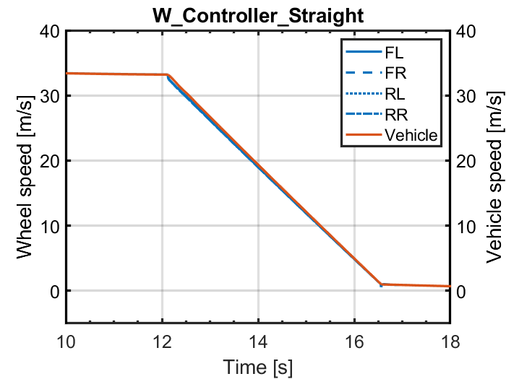
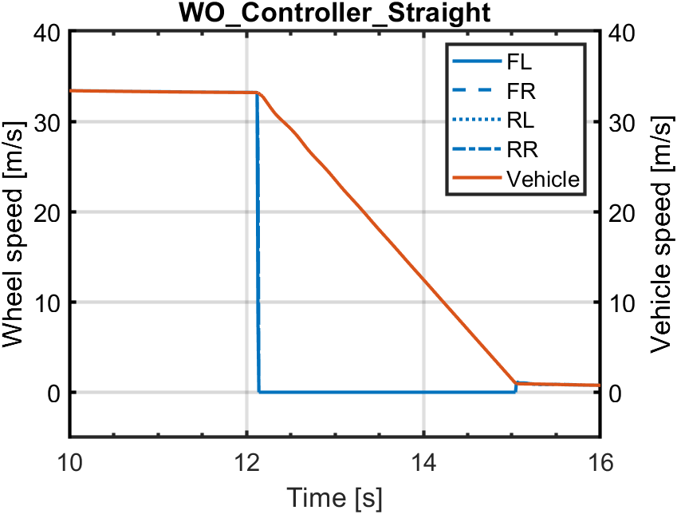
Simulation and Results
Braking on Low friction surface (𝛍 = 0.5)
The car travels straight for 300m at 120km/h and full brake
𝛍 = 0.5

Slide 13
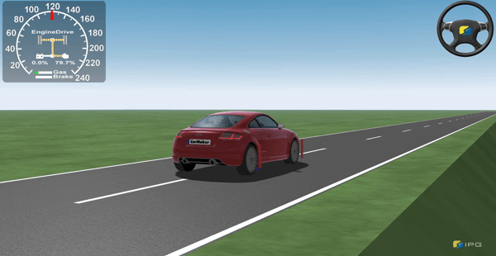
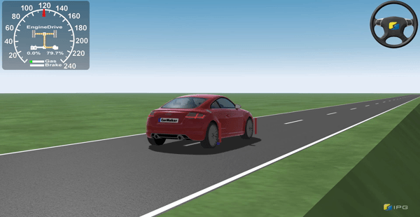
Simulation and Results
w/ Control (𝛍 =0.5)
w/o Control (𝛍 =0.5)
Note steering correction

Slide 14
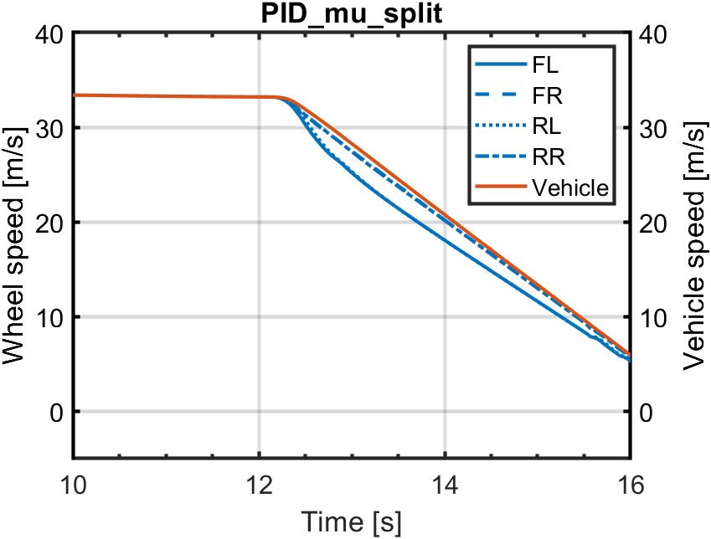
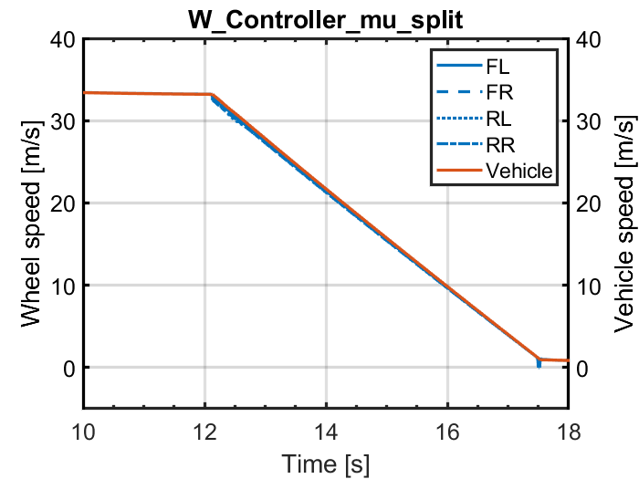
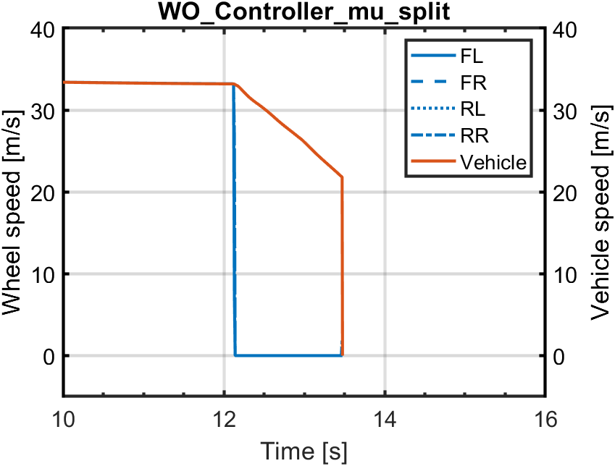
Simulation and Results
Braking on 𝛍-split friction surface
The car travels straight for 300m at 120 km/h and then full brake.
𝛍 = 0.5
𝛍 = 1

Slide 15
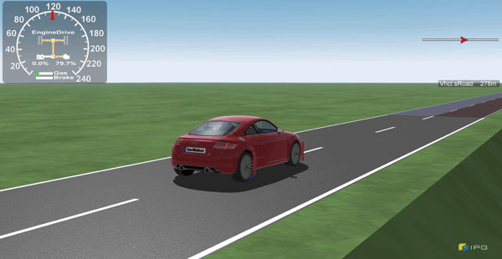
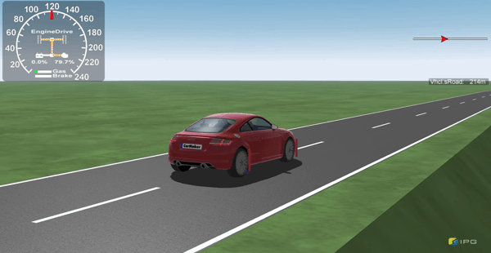
Simulation and Results
w/ Control (𝛍 split)
w/o Control (𝛍 split)

Slide 16
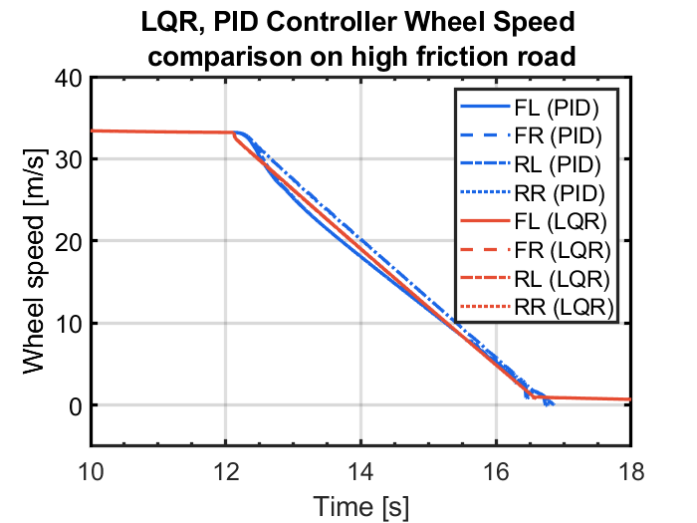
PID, LQR Comparison
Braking from 120km/h at high friction (𝛍 = 1) road.

Slide 17
Conclusions
LQR performance is better than PID for initial conditions
Further tuning is necessary to obtain optimal performance of LQR
Computation time fairly slower than PID control
Inclusion of error dynamics can provide more accurate representation

Slide 18
Future Work
Inclusion of sensor noise
Saturation / Boundary conditions for input to be implemented
Linking with Delft Tyre
Optimise and tune weights for better performance of LQR control
Implement non-linear MPC strategy and compare (possible future work)

Slide 19
Thank you
Questions?
For Block Digram - next slide

Slide 20
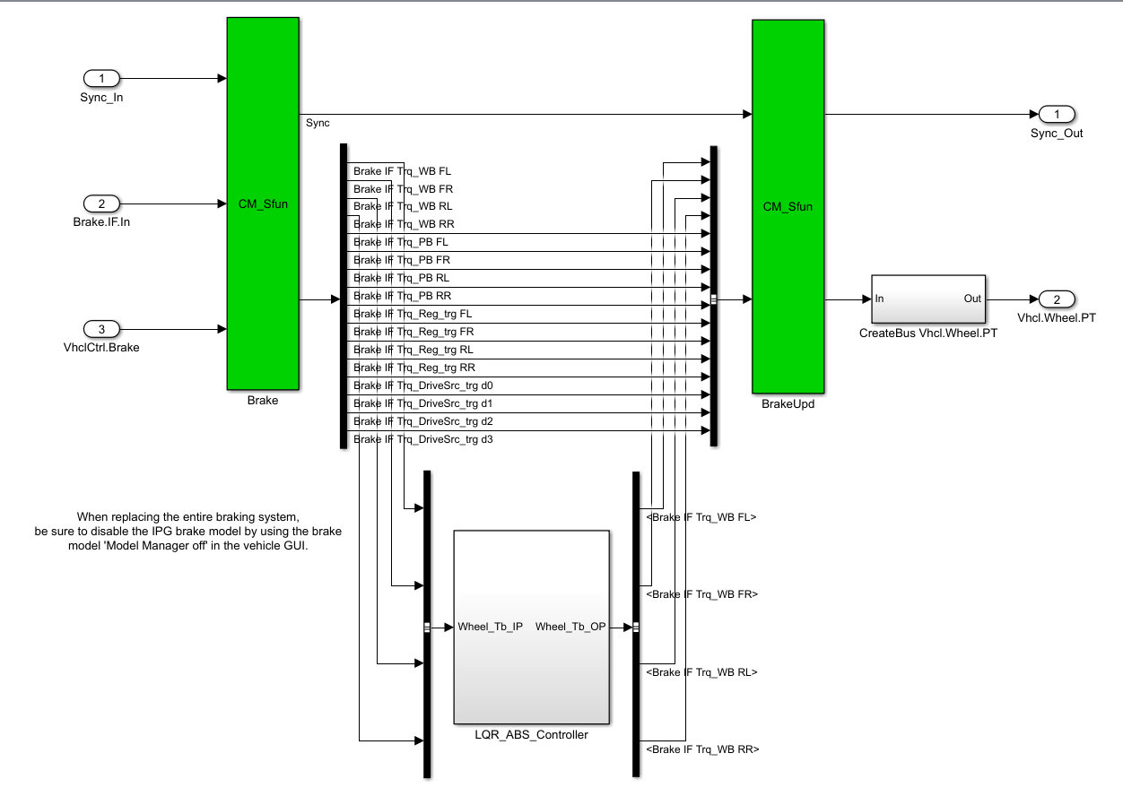
Appendix

Slide 21
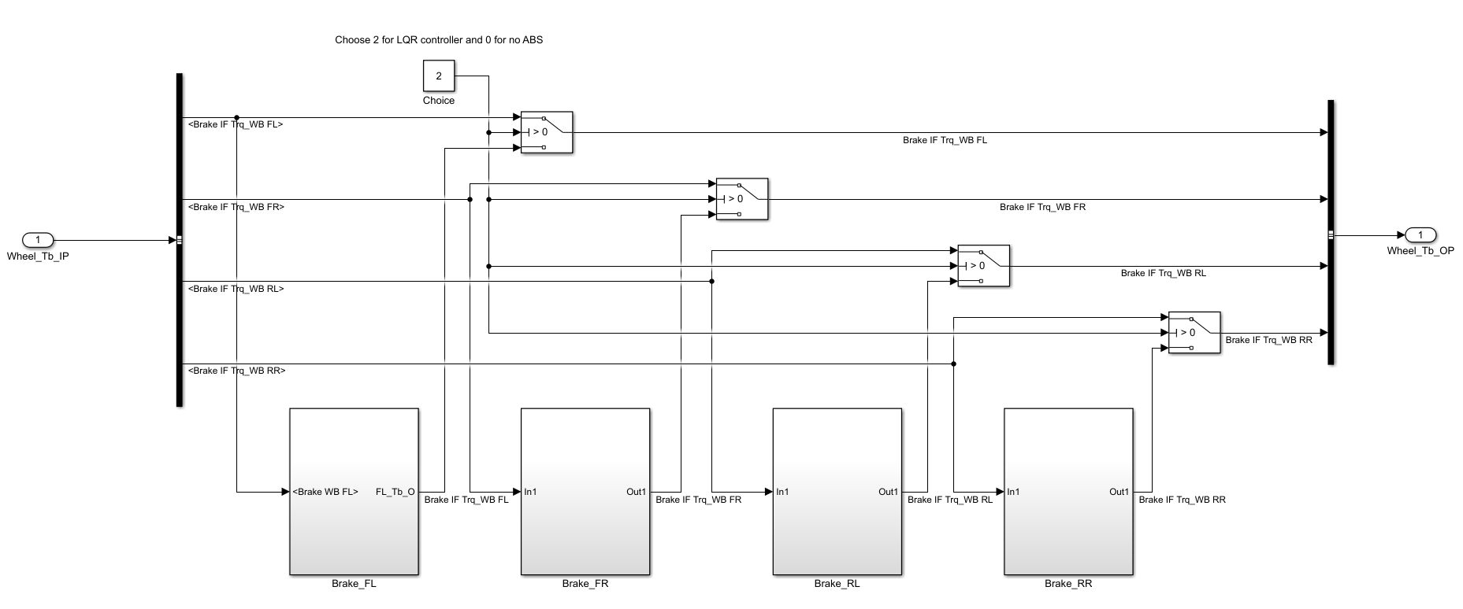
Appendix

